Slide 1

Introduction to
HTML
By Akash Kumar Choudhary

Slide 2
Definitions
W W W – World Wide Web.
HTML – HyperText Markup Language – The Language of Web Pages on the World Wide Web.
HTML is a text formatting language.
URL – Uniform Resource Locator.
Browser – A software program which is used to show web pages.
By Akash Kumar Choudhary

Slide 3
“Normal text” surrounded by bracketed tags that tell browsers how to display web pages
Pages end with “.htm” or “.html”
HTML Editor – A word processor that has been specialized to make the writing of HTML documents more effortless.
By Akash Kumar Choudhary
Notes:
09/22/97
3
University of Minnesota Extension Service
Master Internet Volunteer Program
Provide information in an organized way
Chat Groups
Specialized information areas
Internet access

Slide 4
Tags
Codes enclosed in brackets
Usually paired
  <TITLE>My Web Page</TITLE>
Not case sensitive
  <TITLE> = <title> = <TITLE>
By Akash Kumar Choudhary

Slide 5
Choosing Text Editor
There are many different programs that you can use to create web documents.
HTML Editors enable users to create documents quickly and easily by pushing a few buttons. Instead of entering all of the HTML codes by hand.
These programs will generate the HTML Source Code for you.
By Akash Kumar Choudhary

Slide 6
Choosing Text Editor
HTML Editors are excellent tools for experienced web developers; however; it is important that you learn and understand the HTML language so that you can edit code and fix “bugs” in your pages.
For this Course, we will focus on using the standard Microsoft Windows text editors, NotePad. We may use also textpad.
By Akash Kumar Choudhary

Slide 7
Starting NotePad
NotePad is the standard text editor that comes with the microsoft windows operating system. To start NotePad in windows 9x or XP follow the steps bellow:
Click on the “Start” button located on your Windows task bar.
Click on “Programs” and then click on the directory menu labeled “Accessories”.
Locate the shortcut “NotePad” and click the shortcut once.
By Akash Kumar Choudhary

Slide 8
HTML Page Creation & Editing
In this chapter you will learn to create HTML
pages with a standard text editor.
Objectives
Upon completing this section, you should be able to
1. Choose a Text Editor.
2. Create a Basic Starting Document.
3. Understand and set Document Properties.
4. View Your Results in a Browser.
By Akash Kumar Choudhary

Slide 9
Creating a Basic Starting Document
  <HTML>
  <HEAD>
  <TITLE>GLA University</TITLE>
  </HEAD>
  <BODY>
  This is what is displayed.
  </BODY>
  </HTML>
By Akash Kumar Choudhary
Notes:
09/22/97
9
University of Minnesota Extension Service
Master Internet Volunteer Program
Tech help should be a local or toll-free call
Is it available when you are using the net?
Will you get a real person or have to leave voice mail? (voice mail is OK if the response time is fast and during a time you are not connected)
Try calling tech support before subscribing.

Slide 10
Creating a Basic Starting Document
The HEAD of your document point to above window part. The TITLE of your document appears in the very top line of the user’s browser. If the user chooses to “Bookmark” your page or save as a “Favorite”; it is the TITLE that is added to the list.
The text in your TITLE should be as descriptive as possible because this is what many search engines, on the internet, use for indexing your site.
By Akash Kumar Choudhary

Slide 11
Setting Document Properties
Document properties are controlled by attributes of the BODY element. For example, there are color settings for the background color of the page, the document’s text and different states of links.
By Akash Kumar Choudhary

Slide 12
Color Codes
Colors are set using “RGB” color codes, which are, represented as hexadecimal values. Each 2-digit section of the code represents the amount, in sequence, of red, green or blue that forms the color. For example, a RGB value with 00 as the first two digits has no red in the color.
By Akash Kumar Choudhary

Slide 13

Main Colours
By Akash Kumar Choudhary

Slide 14
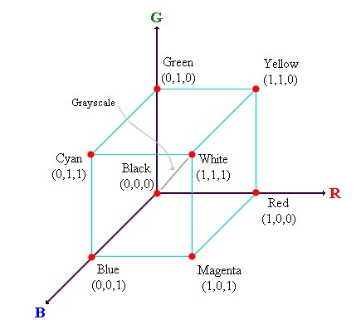
RGB Colour Model
By Akash Kumar Choudhary

Slide 15
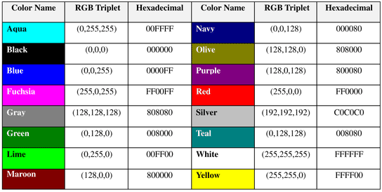
16 Basic Colors
By Akash Kumar Choudhary

Slide 16
Color Codes
WHITE
BLACK
RED
GREEN
BLUE
MAGENTA
CYAN
YELLOW
AQUAMARINE
BAKER’S CHOCOLATE
VIOLET
BRASS
COPPER
PINK
ORANGE
#FFFFFF
#000000
#FF0000
#00FF00
#0000FF
#FF00FF
#00FFFF
#FFFF00
#70DB93
#5C3317
#9F5F9F
#B5A642
#B87333
#FF6EC7
#FF7F00
By Akash Kumar Choudhary

Slide 17
Color Codes
If you require more information about color values, there is an excellent site entitled “VGDesign’s Interactive Color Cube” that displays the background color code when you put your cursor over a small color sample. The Web address is :
http://www.vgdesign.com/color.html
By Akash Kumar Choudhary

Slide 18
The Body Element
The BODY element of a web page is an important element in regards to the page’s appearance. Here are the attributes of the BODY tag to control all the levels:
TEXT="#RRGGBB" to change the color of all the text on the page (full page text color.)
This element contains information about the page’s background color, the background image, as well as the text and link colors.
By Akash Kumar Choudhary

Slide 19
Background Color
It is very common to see web pages with their background color set to white or some other colors.
To set your document’s background color, you need to edit the <BODY> element by adding the BGCOLOR attribute. The following example will display a document with a white background color:
<BODY BGCOLOR=“#FFFFFF”></BODY>
By Akash Kumar Choudhary

Slide 20
TEXT Color
The TEXT attribute is used to control the color of all the normal text in the document. The default color for text is black. The TEXT attribute would be added as follows:
<BODY BGCOLOR=“#FFFFFF” TEXT=“#FF0000”></BODY>
In this example the document’s page
color is white and the text would be red.
By Akash Kumar Choudhary

Slide 21
LINK, VLINK, and ALINK
These attributes control the colors of the different link states:
1. LINK – initial appearance – default = Blue.
2. VLINK – visited link – default = Purple.
3. ALINK –active link being clicked–default= Yellow.
The Format for setting these attributes is:
<BODY BGCOLOR=“#FFFFFF” TEXT=“#FF0000” LINK=“#0000FF”
VLINK=“#FF00FF”
ALINK=“FFFF00”> </BODY>
By Akash Kumar Choudhary

Slide 22
Using Image Background
The BODY element also gives you ability of setting an image as the document’s background.
An example of a background image’s HTML code is as follows:
<BODY BACKGROUND=“hi.gif” BGCOLOR=“#FFFFFF”></BODY>
By Akash Kumar Choudhary

Slide 23
Previewing Your Work
Once you have created your basic starting document and set your document properties it is a good idea to save your file.
To save a file, in NotePad, follow these steps:
Locate and click on the menu called “File”.
Select the option under File Menu labeled “Save As”.
In the “File Name” text box, type in the entire name of your file (including the extension name .html).
By Akash Kumar Choudhary

Slide 24
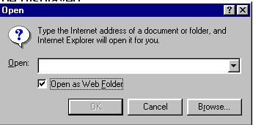
Edit, Save and View Cycle
To preview Your Work, open a web browser and do the following:
Click on the menu labeled “File”.
Locate the menu option, “Open”.
By Akash Kumar Choudhary

Slide 25
Edit, Save and View Cycle
In the “Open” dialog box, click on the “Browse” button and locate your web document.
Click “OK” once you have selected your file.
The web browser will load the same document but with the new revisions. This process is the Edit, Save and View Cycle.
By Akash Kumar Choudhary

Slide 26
Headings, Paragraphs, Breaks & Horizontal Rules
In this chapter you will add headings to your page, insert paragraphs, add some breaks, and add horizontal rules.
Objectives
Upon completing this section, you should be able to
List and describe the different Heading elements.
Use Paragraphs to add text to a document.
Insert breaks where necessary.
Add a Horizontal Rule.
By Akash Kumar Choudhary

Slide 27
Headings, <Hx> </Hx>
Inside the BODY element, heading elements H1 through H6 are generally used for major divisions of the document. Headings are permitted to appear in any order, but you will obtain the best results when your documents are displayed in a browser if you follow these guidelines:
H1: should be used as the highest level of heading, H2 as the next highest, and so forth.
You should not skip heading levels: e.g., an H3 should not appear after an H1, unless there is an H2 between them.
By Akash Kumar Choudhary

Slide 28
Headings, <Hx> </Hx>
<HTML>
<HEAD>
<TITLE> Example Page</TITLE>
</HEAD>
<BODY>
<H1> Heading 1 </H1>
<H2> Heading 2 </H2>
<H3> Heading 3 </H3>
<H4> Heading 4 </H4>
<H5> Heading 5 </H5>
<H6> Heading 6 </H6>
</BODY>
</HTML>
Heading 1
Heading 2
Heading 3
Heading 4
Heading 5
Heading 6
By Akash Kumar Choudhary

Slide 29
Paragraphs, <P> </P>
Paragraphs allow you to add text to a document in such a way that it will automatically adjust the end of line to suite the window size of the browser in which it is being displayed. Each line of text will stretch the entire length of the window.
By Akash Kumar Choudhary

Slide 30
Paragraphs, <P> </P>
<HTML><HEAD>
<TITLE> Example Page</TITLE>
</HEAD>
<BODY></H1> Heading 1 </H1>
<P> Paragraph 1, ….</P>
<H2> Heading 2 </H2>
<P> Paragraph 2, ….</P>
<H3> Heading 3 </H3>
<P> Paragraph 3, ….</P>
<H4> Heading 4 </H4>
<P> Paragraph 4, ….</P>
<H5> Heading 5 </H5>
<P> Paragraph 5, ….</P>
<H6> Heading 6</H6>
<P> Paragraph 6, ….</P>
</BODY></HTML>
Heading 1
Paragraph 1,….
Heading 2
Paragraph 2,….
Heading 3
Paragraph 3,….
Heading 4
Paragraph 4,….
Heading 5
Paragraph 5,….
Heading 6
Paragraph 6,….
By Akash Kumar Choudhary

Slide 31
Break, <BR>
Line breaks allow you to decide where the text will break on a line or continue to the end of the window.
A <BR> is an empty Element, meaning that it may contain attributes but it does not contain content.
The <BR> element does not have a closing tag.
By Akash Kumar Choudhary

Slide 32
Break, <BR>
<HTML>
<HEAD>
<TITLE> Example Page</TITLE>
</HEAD>
<BODY>
<H1> Heading 1 </H1>
<P>Paragraph 1, <BR>
Line 2 <BR> Line 3 <BR>….
</P>
</BODY>
</HTML>
Heading 1
Paragraph 1,….
Line 2
Line 3
….
By Akash Kumar Choudhary

Slide 33
Horizontal Rule, <HR>
The <HR> element causes the browser to display a horizontal line (rule) in your document.
<HR> does not use a closing tag, </HR>.
By Akash Kumar Choudhary

Slide 34
Horizontal Rule, <HR>
Attribute | Description | Default Value
SIZE | Height of the rule in pixels | 2 pixels
WIDTH | Width of the rule in pixels or percentage of screen width | 100%
NOSHADE | Draw the rule with a flat look instead of a 3D look | Not set (3D look)
ALIGN | Aligns the line (Left, Center, Right) | Center
COLOR | Sets a color for the rule (IE 3.0 or later) | Not set
By Akash Kumar Choudhary

Slide 35
Horizontal Rule, <HR>
<HTML>
<HEAD>
<TITLE> Example Page</TITLE>
</HEAD>
<BODY>
<H1> Heading 1 </H1>
<P>Paragraph 1, <BR>
Line 2 <BR>
<HR>Line 3 <BR>
</P>
</BODY>
</HTML>
Heading 1
Paragraph 1,….
Line 2
___________________________
Line 3
By Akash Kumar Choudhary

Slide 36
Character Formatting
In this chapter you will learn how to enhance your page with Bold, Italics, and other character formatting options.
Objectives
Upon completing this section, you should be able to
Change the color and size of your text.
Use Common Character Formatting Elements.
Align your text.
Add special characters.
Use other character formatting elements.
By Akash Kumar Choudhary

Slide 37
Bold, Italic and other Character Formatting Elements
<FONT SIZE=“+2”> Two sizes bigger</FONT>
The size attribute can be set as an absolute value from 1 to 7 or as a relative value using the “+” or “-” sign. Normal text size is 3 (from -2 to +4).
<B> Bold </B>
<I> Italic </I>
<U> Underline </U>
Color = “#RRGGBB” The COLOR attribute of the FONT element. E.g., <FONT COLOR=“#RRGGBB”>this text has color</FONT>
<PRE> Preformatted </PRE> Text enclosed by PRE tags is displayed in a mono-spaced font. Spaces and line breaks are supported without additional elements or special characters.
By Akash Kumar Choudhary

Slide 38
Bold, Italic and other Character Formatting Elements
<EM> Emphasis </EM> Browsers usually display this as italics.
<STRONG> STRONG </STRONG> Browsers display this as bold.
<TT> TELETYPE </TT> Text is displayed in a mono-spaced font. A typewriter text, e.g. fixed-width font.
<CITE> Citation </CITE> represents a document citation (italics). For titles of books, films, etc. Typically displayed in italics. (A Beginner's Guide to HTML)
By Akash Kumar Choudhary

Slide 39
Bold, Italic and other Character Formatting Elements
<P> <FONT SIZE=“+1”> One Size Larger </FONT> - Normal –
<FONT SIZE=“-1”> One Size Smaller </FONT> <BR>
<B> Bold</B> - <I> italics</I> - <U> Underlined </U> -
<FONT COLOR=“#FF0000”> Colored </FONT> <BR>
<EM> Emphasized</EM> - <STRONG> Strong </STRONG> - <TT> Tele Type </TT> <BR>
One Size Larger - Normal – One Size Smaller
Bold - italics - Underlined - Colored
Emphasized - Strong - Tele Type
By Akash Kumar Choudhary

Slide 40
Alignment
Some elements have attributes for alignment (ALIGN) e.g. Headings, Paragraphs and Horizontal Rules.
The Three alignment values are : LEFT, RIGHT, CENTER.
<CENTER></CENTER> Will center elements.
By Akash Kumar Choudhary

Slide 41
Alignment
<DIV ALIGN=“value”></DIV> Represents a division in the document and can contain most other element type. The alignment attribute of the DIV element is well supported.
<TABLE></TABLE> Inside a TABLE, alignment can be set for each individual cell.
By Akash Kumar Choudhary

Slide 42
Special Characters & Symbols
These Characters are recognized in HTML as they begin with an ampersand and end with with a semi-colon e.g. &value; The value will either be an entity name or a standard ASCII character number. They are called escape sequences.
The next table represents some of the more commonly used special characters. For a comprehensive listing, visit the W3C’s section on special characters at: http://www.w3.org/MarkUp/HTMLPlus/htmlplus_13.html
By Akash Kumar Choudhary

Slide 43
Special Characters & Symbols
Special Character | Entity Name | Special Character | Entity Name
Ampersand | &amp; & | Greater-than sign | &gt; >
Asterisk | &lowast; ∗∗ | Less-than sign | &lt; <
Cent sign | &cent; ¢ | Non-breaking space | &nbsp;
Copyright | &copy; © | Quotation mark | &quot; "
Fraction one qtr | &frac14; ¼ | Registration mark | &reg; ®
Fraction one half | &frac12; ½ | Trademark sign | &trade; ™
By Akash Kumar Choudhary

Slide 44
Special Characters & Symbols
Additional escape sequences support accented characters, such as:
&ouml;
  a lowercase o with an umlaut: ö
&ntilde;
  a lowercase n with a tilde: ñ
&Egrave;
  an uppercase E with a grave accent: È
NOTE: Unlike the rest of HTML, the escape sequences are case sensitive. You cannot, for instance, use &LT; instead of &lt;.
By Akash Kumar Choudhary

Slide 45
Additional Character Formatting Elements
<STRIKE> strike-through text</STRIKE>
DEL is used for STRIKE at the latest browsers
<BIG> places text in a big font</BIG>
<SMALL> places text in a small font</SMALL>
<SUB> places text in subscript position </SUB>
<SUP> places text in superscript style position </SUP>
By Akash Kumar Choudhary

Slide 46
Example
<P><STRIKE> strike-through text </STRIKE></BR>
<BIG>places text in a big font </BIG><BR>
<SMALL> places text in a small font</SMALL><BR>
<SUB> places text in subscript position </SUB>
Normal
<SUP> places text in superscript style position </SUP><BR> </P>
By Akash Kumar Choudhary

Slide 47
Lists
In this chapter you will learn how to create a variety of lists.
Objectives
Upon completing this section, you should be able to
Create an unordered list.
Create an ordered list.
Create a defined list.
Nest Lists.
By Akash Kumar Choudhary

Slide 48
List Elements
HTML supplies several list elements. Most list elements are composed of one or more <LI> (List Item) elements.
UL : Unordered List. Items in this list start with a list mark such as a bullet. Browsers will usually change the list mark in nested lists.
<UL>
<LI> List item …</LI>
<LI> List item …</LI>
</UL>
List item …
List item …
By Akash Kumar Choudhary

Slide 49
List Elements
You have the choice of three bullet types: disc(default), circle, square.
These are controlled in Netscape Navigator by the “TYPE” attribute for the <UL> element.
<UL TYPE=“square”>
<LI> List item …</LI>
<LI> List item …</LI>
<LI> List item …</LI>
</UL>
List item …
List item …
List item …
By Akash Kumar Choudhary

Slide 50
List Elements
OL: Ordered List. Items in this list are numbered automatically by the browser.
<OL>
<LI> List item …</LI>
<LI> List item …</LI>
<LI> List item …</LI>
</OL>
List item …
List item …
List item
You have the choice of setting the TYPE Attribute to one of five numbering styles.
By Akash Kumar Choudhary

Slide 51
List Elements
TYPE | Numbering | Styles
1 | Arabic numbers | 1,2,3, ……
a | Lower alpha | a, b, c, ……
A | Upper alpha | A, B, C, ……
i | Lower roman | i, ii, iii, ……
I | Upper roman | I, II, III, ……
By Akash Kumar Choudhary

Slide 52
List Elements
You can specify a starting number for an ordered list.
<OL TYPE =“i”>
<LI> List item …</LI>
<LI> List item …</LI>
</OL>
<P> text ….</P>
<OL TYPE=“i” START=“3”>
<LI> List item …</LI>
</OL>
By Akash Kumar Choudhary

Slide 53
List Elements
List item …
List item …
Text ….
List item …
By Akash Kumar Choudhary

Slide 54
List Elements
DL: Definition List. This kind of list is different from the others. Each item in a DL consists of one or more Definition Terms (DT elements), followed by one or more Definition Description (DD elements).
<DL>
<DT> HTML </DT>
<DD> Hyper Text Markup Language </DD>
<DT> DOG </DT>
<DD> A human’s best friend!</DD>
</DL>
HTML
Hyper Text Markup Language
DOG
A human’s best friend!
By Akash Kumar Choudhary

Slide 55
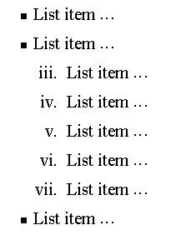
Nesting Lists
You can nest lists by inserting a UL, OL, etc., inside a list item (LI).
EXample
<UL TYPE = “square”>
<LI> List item …</LI>
<LI> List item …
<OL TYPE=“i” START=“3”>
<LI> List item …</LI>
<LI> List item …</LI>
<LI> List item …</LI>
<LI> List item …</LI>
<LI> List item …</LI>
</OL>
</LI>
<LI> List item …</LI>
</UL>
By Akash Kumar Choudhary

Slide 56
What will be the output?
<H1 ALIGN="CENTER">SAFETY TIPS FOR CANOEISTS</H1>
<OL TYPE=“a” START=“2”>
<LI>Be able to swim </LI>
<LI>Wear a life jacket at all times </LI>
<LI>Don't stand up or move around. If canoe tips,
  <UL>
  <LI>Hang on to the canoe </LI>
  <LI>Use the canoe for support and </LI>
  <LI>Swim to shore
  </UL> </LI>
<LI>Don't overexert yourself </LI>
<LI>Use a bow light at night </LI>
</OL>
By Akash Kumar Choudhary

Slide 57
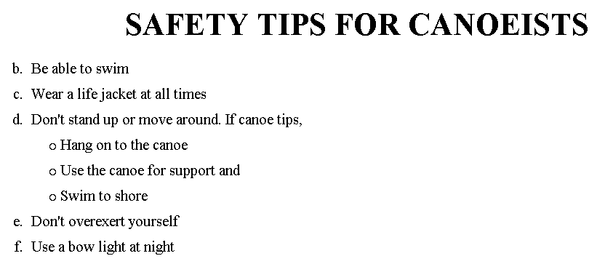
The output….
By Akash Kumar Choudhary

Slide 58
<H1 ALIGN="CENTER">SAFETY TIPS FOR CANOEISTS</H1>
<OL TYPE="a" START="2">
<LI>Be able to swim </LI>
<LI>Wear a life jacket at all times </LI>
<LI>Don't stand up or move around. If canoe tips,
<UL>
<LI>Hang on to the canoe </LI>
<LI>Use the canoe for support
<OL type="I" start="4">
<LI> Be careful </LI>
<LI> Do not look around</LI>
</LI> </OL>
<LI>Swim to shore
</UL> </LI>
<LI>Don't overexert yourself </LI>
<LI>Use a bow light at night </LI>
</OL>
What
will
be the
output?
By Akash Kumar Choudhary

Slide 59
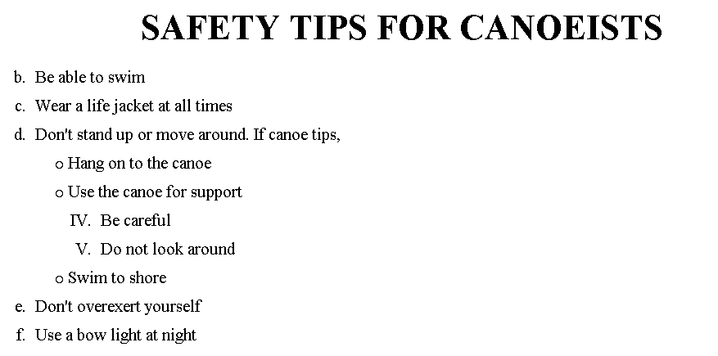
The output….
By Akash Kumar Choudhary

Slide 60
Images
In this chapter you will learn about images and how to place images in your pages.
Objectives
Upon completing this section, you should be able to
Add images to your pages.
By Akash Kumar Choudhary

Slide 61
Images
<IMG>This element defines a graphic image on the page.
Image File (SRC:source): This value will be a URL (location of the image) E.g. http://www.domain.com/dir/file.ext or /dir/file.txt.
Alternate Text (ALT): This is a text field that describes an image or acts as a label. It is displayed when they position the cursor over a graphic image.
Alignment (ALIGN): This allows you to align the image on your page.
By Akash Kumar Choudhary

Slide 62
Images
Width (WIDTH): is the width of the image in pixels.
Height (HEIGHT): is the height of the image in pixels.
Border (BORDER): is for a border around the image, specified in pixels.
HSPACE: is for Horizontal Space on both sides of the image specified in pixels. A setting of 5 will put 5 pixels of invisible space on both sides of the image.
VSPACE: is for Vertical Space on top and bottom of the image specified in pixels. A setting of 5 will put 5 pixels of invisible space above and bellow the image.
By Akash Kumar Choudhary

Slide 63
Some Examples on images
1) <IMG SRC=“jordan.gif“ border=4>
2) <IMG SRC=" jordan.gif" width="60" height="60">
3) <IMG SRC=“jordan.gif" ALT="This is a text that goes with the image">
4) <IMG SRC=" jordan.gif “ Hspace="30" Vspace="10" border=20>
5) < IMG SRC =" jordan.gif“ align="left">
blast blast blast blast blast
By Akash Kumar Choudhary

Slide 64
Anchors, URLs and Image Maps
In this chapter you will learn about Uniform Resource Locator, and how to add them as Anchor or Links inside your web pages.
Objectives
Upon completing this section, you should be able to
Insert links into documents.
Define Link Types.
Define URL.
List some commonly used URLs.
Plan an Image Map.
By Akash Kumar Choudhary

Slide 65
HOW TO MAKE A LINK
1) The tags used to produce links are the <A>
and </A>. The <A> tells where the link should start and
the </A> indicates where the link ends. Everything between
these two will work as a link.
2) The example below shows how to make the word
Here work as a link to yahoo.
Click <A HREF="http://www.yahoo.com">here</A> to
go to yahoo.
By Akash Kumar Choudhary

Slide 66
More on LINKs
<body LINK="#C0C0C0" VLINK="#808080" ALINK="#FF0000">
LINK - standard link - to a page the visitor hasn't been to yet. (standard color is blue - #0000FF).
VLINK - visited link - to a page the visitor has been to before. (standard color is purple - #800080).
ALINK - active link - the color of the link when the mouse is on it. (standard color is red - #FF0000).
If the programmer what to change the color
Click <a href="http://www.yahoo.com"><font color="FF00CC">here</font></a> to go to yahoo.
By Akash Kumar Choudhary

Slide 67
Internal Links
Internal Links : Links can also be created inside large documents to simplify navigation. Today’s world wants to be able to get the information quickly. Internal links can help you meet these goals.
Select some text at a place in the document that you would like to create a link to, then add an anchor to link to like this:
<A NAME=“bookmark_name”></A>
The Name attribute of an anchor element specifies a location in the document that we link to shortly. All NAME attributes in a document must be unique.
Next select the text that you would like to create as a link to the location created above.
<A HREF=“#bookmark_name”>Go To Book Mark</A>
By Akash Kumar Choudhary

Slide 68
E-Mail (Electronic Mail)
E.g. mailto:kmf@yahoo.com
The type of service is identified as the mail client program. This type of link will launch the users mail client.
The recipient of the message is kmf@yahoo.com
<A HREF=“mailto:kmf@yahoo.com”>Send me
More Information </A>
By Akash Kumar Choudhary

Slide 69
Tables
In this chapter you will learn that tables have many uses in
HTML.
Objectives:
Upon completing this section, you should be able to:
Insert a table.
Explain a table’s attributes.
Edit a table.
Add a table header.
By Akash Kumar Choudhary

Slide 70
Tables
The <TABLE></TABLE> element has four sub-elements:
Table Row<TR></TR>.
Table Header <TH></TH>.
Table Data <TD></TD>.
Caption <CAPTION></CAPTION>.
The table row elements usually contain table header elements or table data elements.
By Akash Kumar Choudhary

Slide 71
Tables
<table border=“1”>
<tr>
<th> Column 1 header </th>
<th> Column 2 header </th>
</tr>
<tr>
<td> Row1, Col1 </td>
<td> Row1, Col2 </td>
</tr>
<tr>
<td> Row2, Col1 </td>
<td> Row2, Col2 </td>
</tr>
</table>
By Akash Kumar Choudhary

Slide 72
Tables
Column 1 Header | Column 2 Header
Row1, Col1 | Row1, Col2
Row2, Col1 | Row2, Col2
By Akash Kumar Choudhary

Slide 73
Tables Attributes
BGColor: Some browsers support background colors in a table.
Width: you can specify the table width as an absolute number of pixels or a percentage of the document width. You can set the width for the table cells as well.
Border: You can choose a numerical value for the border width, which specifies the border in pixels.
CellSpacing: Cell Spacing represents the space between cells and is specified in pixels.
By Akash Kumar Choudhary

Slide 74
Table Attributes
CellPadding: Cell Padding is the space between the cell border and the cell contents and is specified in pixels.
Align: tables can have left, right, or center alignment.
Background: Background Image, will be titled in IE3.0 and above.
BorderColor, BorderColorDark.
By Akash Kumar Choudhary

Slide 75
Table Caption
A table caption allows you to specify a line of text that will appear centered above or bellow the table.
<TABLE BORDER=1 CELLPADDING=2>
<CAPTION ALIGN=“BOTTOM”> Label For My Table </CAPTION>
The Caption element has one attribute ALIGN that can be either TOP (Above the table) or BOTTOM (below the table).
By Akash Kumar Choudhary

Slide 76
Table Header
Table Data cells are represented by the TD element. Cells can also be TH (Table Header) elements which results in the contents of the table header cells appearing centered and in bold text.
By Akash Kumar Choudhary

Slide 77
Table Data and Table Header Attributes
Colspan: Specifies how many cell columns of the table this cell should span.
Rowspan: Specifies how many cell rows of the table this cell should span.
Align: cell data can have left, right, or center alignment.
Valign: cell data can have top, middle, or bottom alignment.
Width: you can specify the width as an absolute number of pixels or a percentage of the document width.
Height: You can specify the height as an absolute number of pixels or a percentage of the document height.
By Akash Kumar Choudhary

Slide 78
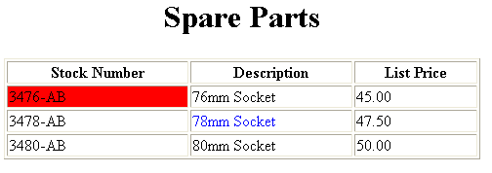
Basic Table Code
<TABLE BORDER=1 width=50%>
<CAPTION> <h1>Spare Parts <h1> </Caption>
<TR><TH>Stock Number</TH><TH>Description</TH><TH>List Price</TH></TR>
<TR><TD bgcolor=red>3476-AB</TD><TD>76mm Socket</TD><TD>45.00</TD></TR>
<TR><TD >3478-AB</TD><TD><font color=blue>78mm Socket</font> </TD><TD>47.50</TD></TR>
<TR><TD>3480-AB</TD><TD>80mm Socket</TD><TD>50.00</TD></TR>
</TABLE>
By Akash Kumar Choudhary

Slide 79
Table Data and Table Header Attributes
<Table border=1 cellpadding =2>
<tr> <th> Column 1 Header</th> <th> Column 2 Header</th> </tr>
<tr> <td colspan=2> Row 1 Col 1</td> </tr>
<tr> <td rowspan=2>Row 2 Col 1</td>
<td> Row 2 Col2</td> </tr>
<tr> <td> Row 3 Col2</td> </tr>
</table>
By Akash Kumar Choudhary

Slide 80
Table Data and Table Header Attributes
Column 1 Header | Column 2 Header
Row 1 Col 1
Row 2 Col 1 | Row 2 Col 2
 | Row 3 Col 2
By Akash Kumar Choudhary

Slide 81
Special Things to Note
TH, TD and TR should always have end tags.
Although the end tags are formally optional, many browsers will mess up the formatting of the table if you omit the end tags. In particular, you should always use end tags if you have a TABLE within a TABLE -- in this situation, the table parser gets hopelessly confused if you don't close your TH, TD and TR elements.
A default TABLE has no borders
By default, tables are drawn without border lines. You need the BORDER attribute to draw the lines.
By default, a table is flush with the left margin
TABLEs are plopped over on the left margin. If you want centered tables, You can either: place the table inside a DIV element with attribute ALIGN="center".
Most current browsers also supports table alignment, using the ALIGN attribute. Allowed values are "left", "right", or "center", for example: <TABLE ALIGN="left">. The values "left" and "right" float the table to the left or right of the page, with text flow allowed around the table. This is entirely equivalent to IMG alignment
By Akash Kumar Choudhary

Slide 82
What will be the output?
    <TABLE BORDER width=“750”>
    <TR> <TD colspan=“4” align=“center”>Page Banner</TD></TR>
    <TR> <TD rowspan=“2” width=“25%”>Nav Links</TD><TD colspan=“2”>Feature Article</TD> <TD rowspan=“2” width=“25%”>Linked Ads</TD></TR>
    <TR><TD width=“25%”>News Column 1 </TD> <TD width=“25%”><News Column 2 </TD></TR>
    </TABLE>
By Akash Kumar Choudhary

Slide 83
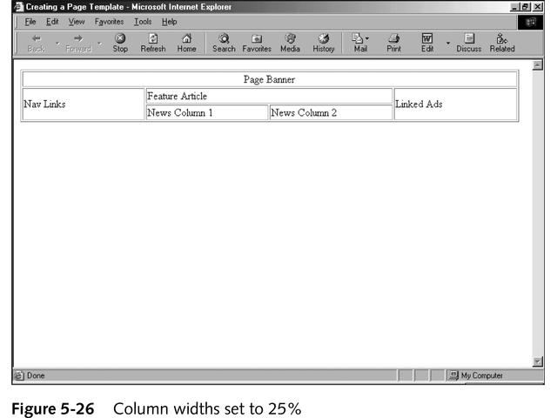
The Output
By Akash Kumar Choudhary

Slide 84
Targets
When you use links for use in a frames environment you will need to specify an additional attribute called TARGET.
The TARGET attribute uses the NAME attribute of the FRAME element.
If we were to place a link in doc1.html that linked to doc3.html and we wanted doc3.html to be displayed in the right windowpane; the HTML code would appear in doc1.html as follows:
<A HREF=“doc3.html” TARGET=“right_pane”>Link to Document 3 </A>
By Akash Kumar Choudhary

Slide 85
Special Targets
There are 4 special target names that cannot be assigned by the NAME attribute of the FRAME tag.
1. TARGET=“_top” : This loads the linked document into the full browser window with the URL specified by the HREF attribute. All frames disappear, leaving the new linked page to occupy the entire window. The back is turned on.
2. TARGET=“_blank” : Opens an unnamed new browser window and loads the document specified in the URL attribute into the new window (and your old window stays open). The back is turned off. Other windows remains on.
3. TARGET=“_self” : Loads the document in the same window where the anchor was {Clicked}. This is the default setting for linking elements.
4. TARGET=“_parent” : the _parent frame is a prior frameset that the current frameset was “spawned” from. If there isn’t one it is the browser window. The document is loaded into the area occupied by the columns or rows frameset containing the frame that contains the link. The back is turned on. All windows disappear.
By Akash Kumar Choudhary

Slide 86
If a frame contains the following link, then clicking the link launches a new, unnamed browser display window that contains the content defined in stuff.HTM. This can be a simple HTML document, or an entirely new FRAMESET definition.
1. <A HREF="stuff.html" TARGET="_blank">
If a frame contains the following link, then clicking the link will simply cause the frame which contains the link to clear, and its content will be replaced with whatever is in stuff.htm.
2. <A HREF="stuff.html" TARGET="_self">
If a frame contains the following link, the frameset that contains the frame that contains this link will be replaced by stuff.HTM.
3. <A HREF="stuff.html" TARGET="_parent">
Finally, if a frame contains the following link, clicking the link replaces the entire browser window with the contents of stuff.HTM.
4. <A HREF="stuff.html" TARGET="_top">
By Akash Kumar Choudhary

Slide 87
Targeting links to frames
The TARGET attribute allows you to specify the frame into which a page is to be loaded into in a frames setting.
<A HREF=“chap1.html” TARGET=“_self”> [Chapter 1]</A>
<A HREF=“chap1.html” TARGET=“_parent”> [Chapter 2]</A>
Parent window
chap1.html
Learning HTML
[Chapter 1][Chapter 2][Chapter 3]
chap2.html
By Akash Kumar Choudhary

Slide 88
Targeting links to frames
The TARGET attribute allows you to specify the frame into which a page is to be loaded into in a frames setting.
<A HREF=“chap1.html” TARGET=“bottom”> [Chapter 1]</A>
<A HREF=“chap2.html” TARGET=“bottom”> [Chapter 2]</A>
<A HREF=“chap3.html” TARGET=“bottom”> [Chapter 3]</A>
chap1.html
Learning HTML
[Chapter 1][Chapter 2][Chapter 3]
chap2.html
chap3.html
By Akash Kumar Choudhary

Slide 89
Forms
Forms add the ability to web pages to not only provide the person viewing the document with dynamic information but also to obtain information from the person viewing it, and process the information.
Objectives:
Upon completing this section, you should be able to
Create a FORM.
Add elements to a FORM.
Define CGI (Common Gateway Interface).
Describe the purpose of a CGI Application.
Specify an action for the FORM.
Forms work in all browsers.
Forms are Platform Independent.
By Akash Kumar Choudhary

Slide 90
Forms
To insert a form we use the <FORM></FORM> tags. The rest of the form elements must be inserted in between the form tags.
<HTML> <HEAD>
<TITLE> Sample Form</TITLE>
</HEAD>
<BODY BGCOLOR=“FFFFFF”>
<FORM ACTION = http://www.xnu.com/formtest.asp>
<P> First Name: <INPUT TYPE=“TEXT” NAME=“fname” MAXLENGTH=“50”> </P>
<P> <INPUT TYPE=“SUBMIT” NAME=“fsubmit1” VALUE=“Send Info”> </P>
</FORM>
</BODY> </HTML>
By Akash Kumar Choudhary

Slide 91
<FORM> element attributes
ACTION: is the URL of the CGI (Common Gateway Interface) program that is going to accept the data from the form, process it, and send a response back to the browser.
METHOD: GET (default) or POST specifies which HTTP method will be used to send the form’s contents to the web server. The CGI application should be written to accept the data from either method.
NAME: is a form name used by VBScript or
JavaScripts.
TARGET: is the target frame where the response page will show up.
By Akash Kumar Choudhary

Slide 92
Form Elements
Form elements have properties: Text boxes, Password boxes, Checkboxes, Option(Radio) buttons, Submit, Reset, File, Hidden and Image.
The properties are specified in the TYPE Attribute of the HTML element <INPUT></INPUT>.
By Akash Kumar Choudhary

Slide 93
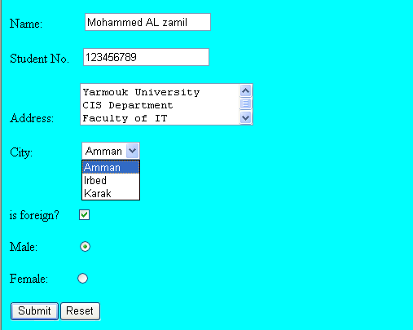
Sami Ali
Al al-Bayt University
By Akash Kumar Choudhary

Slide 94
Form Elements
<INPUT> Element’s Properties
TYPE= Type of INPUT entry field.
NAME = Variable name passed to CGI application
VALUE= The data associated with the variable name to be passed to the CGI application
CHECKED= Button/box checked
SIZE= Number of visible characters in text field
MAXLENGHT= Maximum number of characters accepted.
By Akash Kumar Choudhary

Slide 95

Text Box
Text boxes: Used to provide input fields for text, phone numbers, dates, etc.
<INPUT TYPE= " TEXT " >
Browser will display
Textboxes use the following attributes:
TYPE: text.
SIZE: determines the size of the textbox in characters. Default=20 characters.
MAXLENGHT : determines the maximum number of characters that the field will accept.
NAME: is the name of the variable to be sent to the CGI application.
VALUE: will display its contents as the default value.
By Akash Kumar Choudhary

Slide 96
Example on Text Box
<TITLE>Form_Text_Type</TITLE>
</HEAD> <BODY>
<h1> <font color=blue>Please enter the following bioData</font></h1>
<FORM name="fome1" Method= " get " Action= " URL " >
First Name: <INPUT TYPE="TEXT" NAME="FName"
SIZE="15" MAXLENGTH="25"><BR>
Last Name: <INPUT TYPE="TEXT" NAME="LName"
SIZE="15" MAXLENGTH="25"><BR>
Nationality: <INPUT TYPE="TEXT" NAME="Country"
SIZE="25" MAXLENGTH="25"><BR>
The Phone Number: <INPUT TYPE="TEXT" NAME="Phone"
SIZE="15" MAXLENGTH="12"><BR>
</FORM> </BODY> </HTML>
By Akash Kumar Choudhary

Slide 97
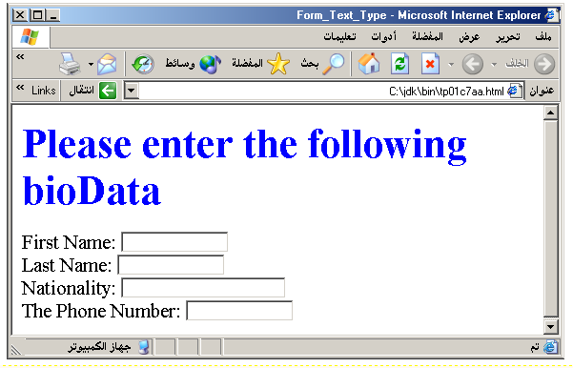
Output
By Akash Kumar Choudhary

Slide 98
Password
Password: Used to allow entry of passwords.
<INPUT TYPE= " PASSWORD " >
Browser will display
Text typed in a password box is starred out in the browser
display.
Password boxes use the following attributes:
TYPE: password.
SIZE: determines the size of the textbox in characters.
MAXLENGHT: determines the maximum size of the password in characters.
NAME: is the name of the variable to be sent to the CGI application.
VALUE: is usually blank.
By Akash Kumar Choudhary

Slide 99
Example on Password Box
<HTML><HEAD>
<TITLE>Form_Password_Type</TITLE></HEAD>
<BODY>
<h1> <font color=red>To Access, Please
enter:</font></h1>
<FORM name="fome2" Action="url" method="get">
User Name: <INPUT TYPE="TEXT" Name="FName"
SIZE="15" MAXLENGTH="25"><BR>
Password: <INPUT TYPE="PASSWORD"
NAME="PWord" value="" SIZE="15”
MAXLENGTH="25"><BR>
</FORM></BODY> </HTML>
By Akash Kumar Choudhary

Slide 100
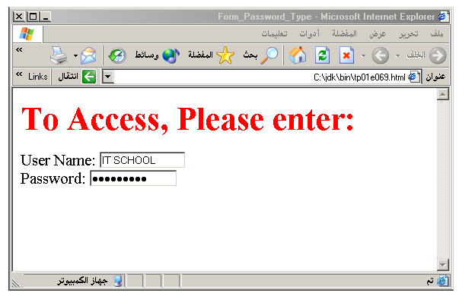
Output
By Akash Kumar Choudhary

Slide 101
Hidden
Hidden: Used to send data to the CGI application that you don’t want the web surfer to see, change or have to enter but is necessary for the application to process the form correctly.
<INPUT TYPE=“HIDDEN”>
Nothing is displayed in the browser.
Hidden inputs have the following attributes:
TYPE: hidden.
NAME: is the name of the variable to be sent to the CGI application.
VALUE: is usually set a value expected by the CGI application.
By Akash Kumar Choudhary

Slide 102
Check Box
Check Box: Check boxes allow the users to select more than one option.
<INPUT TYPE=“CHECKBOX”>
Browser will display
Checkboxes have the following attributes:
TYPE: checkbox.
CHECKED: is blank or CHECKED as the initial
status.
NAME: is the name of the variable to be sent to the
CGI application.
VALUE: is usually set to a value.
By Akash Kumar Choudhary

Slide 103
<HTML> <HEAD><TITLE>CheckBoxType</TITLE> </HEAD>
<BODY>
<h1> <font color=green>Please check one of the following</font></h1>
<FORM name="fome3" Action="url" method="get">
<font color=red> Select Country: </font><BR>
jordan:<INPUT TYPE="CheckBox" Name="country" CHECKED><BR>
Yemen<INPUT TYPE="CheckBox" Name="country"><BR>
Qatar:<INPUT TYPE="CheckBox" Name="country"><BR> <BR>
<font color=blue>Select Language:</font><BR>
Arabic:<INPUT TYPE="CheckBox" Name="language" CHECKED><BR> English:<INPUT TYPE="CheckBox" Name="language"><BR>
French:<INPUT TYPE="CheckBox" Name="language"> <BR></FORM> </BODY></HTML>
By Akash Kumar Choudhary

Slide 104
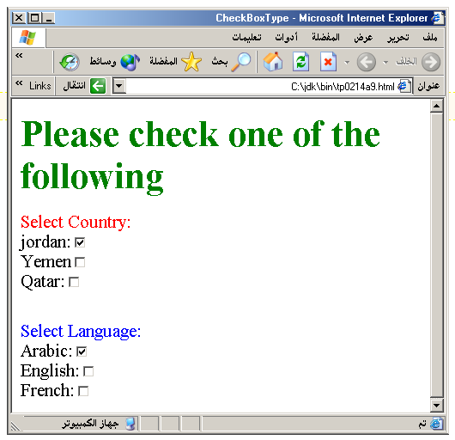
Output
By Akash Kumar Choudhary

Slide 105
Radio Button
Radio Button: Radio buttons allow the users to select
only one option.
<INPUT TYPE=“RADIO”>
Browser will display
Radio buttons have the following attributes:
TYPE: radio.
CHECKED: is blank or CHECKED as the initial
status. Only one radio button can be
checked
NAME: is the name of the variable to be sent to the
CGI application.
VALUE: usually has a set value.
By Akash Kumar Choudhary

Slide 106
<HTML> <HEAD><TITLE>CheckBoxType</TITLE> </HEAD>
<BODY>
<h1> <font color=green>Please check one of the following</font></h1>
<FORM name="fome3" Action="url" method="get">
<font color=red> Select Country: </font><BR>
jordan:<INPUT TYPE= "RADIO" Name="country" CHECKED><BR>
Yemen<INPUT TYPE="RADIO " Name="country"><BR>
Qatar:<INPUT TYPE="RADIO" Name="country"><BR> <BR>
<font color=blue>Select Language:</font><BR>
Arabic:<INPUT TYPE="RADIO" Name="language" CHECKED><BR> English:<INPUT TYPE=" RADIO " Name="language"><BR>
French:<INPUT TYPE=" RADIO " Name="language"> <BR></FORM> </BODY></HTML>
By Akash Kumar Choudhary

Slide 107
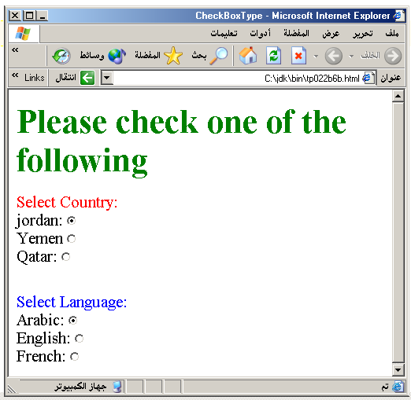
By Akash Kumar Choudhary

Slide 108
<HTML><HEAD>
<TITLE>RADIOBox</TITLE> </HEAD>
<BODY>
Form #1:
<FORM>
<INPUT TYPE="radio" NAME="choice" VALUE="one"> Yes.
<INPUT TYPE="radio" NAME="choice" VALUE="two"> No.
</FORM>
<HR color=red size="10" >
Form #2:
<FORM>
<INPUT TYPE="radio" NAME="choice" VALUE="three" CHECKED> Yes.
<INPUT TYPE="radio" NAME="choice" VALUE="four"> No.
</FORM>
</BODY></HTML>
By Akash Kumar Choudhary

Slide 109
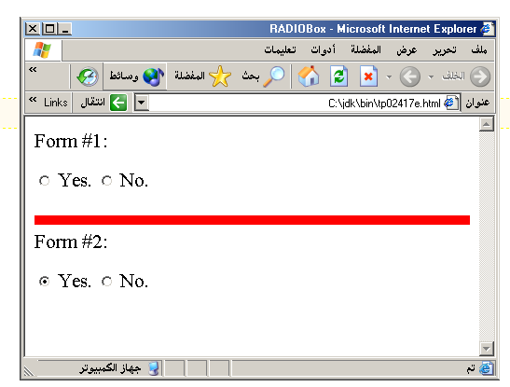
Output
By Akash Kumar Choudhary

Slide 110
Push Button
Push Button: This element would be used with
JavaScript to cause an action to take place.
<INPUT TYPE=“BUTTON”>
Browser will display
Push Button has the following attributes:
TYPE: button.
NAME: is the name of the button to be used
in scripting.
VALUE: determines the text label on the button.
By Akash Kumar Choudhary

Slide 111
<DIV align=center><BR><BR>
<FORM>
<FONT Color=red>
<h1>Press Here to see a baby crying:<BR>
<INPUT TYPE="button" VALUE="PressMe"><BR><BR>
<FONT Color=blue>
Click Here to see a baby shouting:<BR>
<INPUT TYPE="button" VALUE="ClickMe" > <BR><BR>
<FONT Color=green>
Hit Here to see a baby eating:<BR>
<INPUT TYPE="button" VALUE="HitME" > <BR><BR>
<FONT Color=yellow>
</FORM></DIV>
By Akash Kumar Choudhary

Slide 112
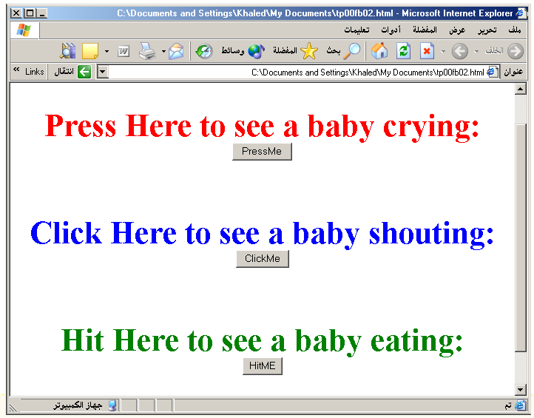
By Akash Kumar Choudhary

Slide 113
Submit Button
Submit: Every set of Form tags requires a Submit button. This is the element causes the browser to send the names and values of the other elements to the CGI Application specified by the ACTION attribute of the FORM element.
<INPUT TYPE=“SUBMIT”>
The browser will display
Submit has the following attributes:
TYPE: submit.
NAME: value used by the CGI script for processing.
VALUE: determines the text label on the button, usually Submit Query.
By Akash Kumar Choudhary

Slide 114
<FORM Action="URL" method="get">
First Name: <INPUT TYPE="TEXT" Size=25 name="firstName"><BR>
Family Name: <INPUT TYPE="TEXT" Size=25 name="LastName"><BR>
<BR>
<FONT Color=red>
Press Here to submit the data:<BR>
<INPUT TYPE="submit" VALUE="SubmitData " >
</FORM>
By Akash Kumar Choudhary

Slide 115
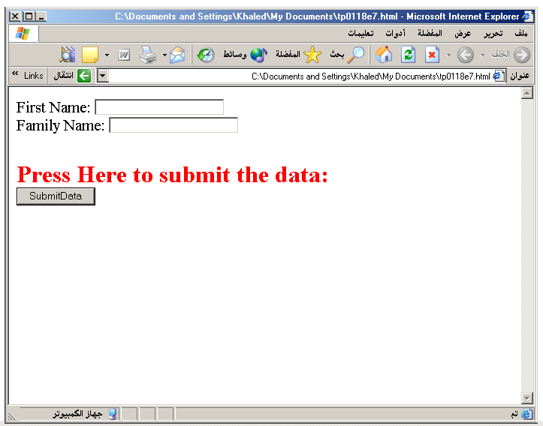
By Akash Kumar Choudhary

Slide 116
Reset Button
Reset: It is a good idea to include one of these for each form where users are entering data. It allows the surfer to clear all the input in the form.
<INPUT TYPE=“RESET”>
Browser will display
Reset buttons have the following attributes:
TYPE: reset.
VALUE: determines the text label on the button, usually Reset.
By Akash Kumar Choudhary

Slide 117
<FORM Action="URL" method="get">
First Name: <INPUT TYPE="TEXT" Size=25 name="firstName"> <BR>
Family Name: <INPUT TYPE="TEXT" Size=25 name="LastName"><BR>
<BR>
<FONT Color = red>
<STRONG><font size=5>Press Here to submit the data:</font></STRONG><BR>
<INPUT TYPE="submit" VALUE="SubmitData">
<INPUT TYPE="RESET" VALUE="Reset">
</FORM>
By Akash Kumar Choudhary

Slide 118
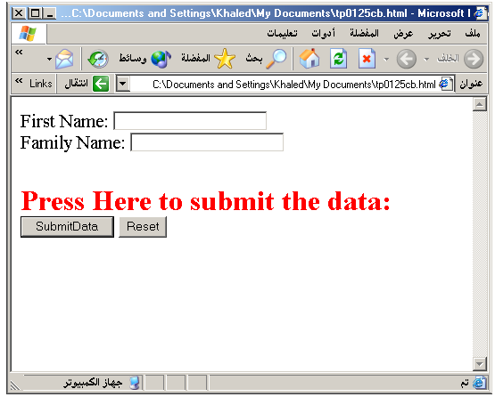
By Akash Kumar Choudhary

Slide 119
Image Submit Button
Image Submit Button: Allows you to substitute an image for the standard submit button.
<INPUT TYPE=“IMAGE” SRC=“jordan.gif”>
Image submit button has the following attributes:
TYPE: Image.
NAME: is the name of the button to be used in scripting.
SRC: URL of the Image file.
By Akash Kumar Choudhary

Slide 120
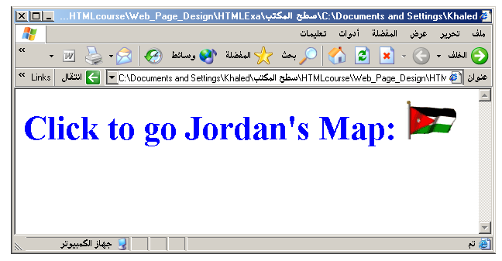
<form>
<H1><font color=blue>
Click to go Jordan’s Map:
<INPUT TYPE="IMAGE" SRC="jordan.gif">
</form>
By Akash Kumar Choudhary

Slide 121

File
File Upload: You can use a file upload to allow surfers to upload files to your web server.
<INPUT TYPE=“FILE”>
Browser will display
File Upload has the following attributes:
TYPE: file.
SIZE: is the size of the text box in characters.
NAME: is the name of the variable to be sent to the
CGI application.
MAXLENGHT: is the maximum size of the input in the
textbox in characters.
By Akash Kumar Choudhary

Slide 122
<BODY bgcolor=lightblue>
<form>
<H3><font color=forestgreen>
Please attach your file here to for uploading to
My <font color =red>SERVER...<BR>
<INPUT TYPE="File" name="myFile" size="30">
<INPUT TYPE="Submit" value="SubmitFile">
</form>
</BODY>
By Akash Kumar Choudhary

Slide 123
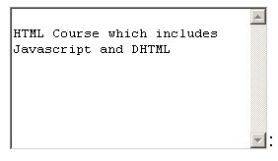
Other Elements used in Forms
<TEXTAREA></TEXTAREA>: is an element that allows for free form text entry.
Browser will display
Textarea has the following attributes:
NAME: is the name of the variable to be sent to the CGI application.
ROWS: the number of rows to the textbox.
COLS: the number of columns to the textbox.
By Akash Kumar Choudhary

Slide 124
<BODY bgcolor=lightblue>
<form>
<TEXTAREA COLS=40 ROWS=20 Name="comments" >
From observing the apathy of those
about me during flag raising I
concluded that patriotism if not
actually on the decline is at least
in a state of dormancy.
Written by Khaled Al-Fagih
</TEXTAREA>:
</form>
</BODY>
By Akash Kumar Choudhary

Slide 125
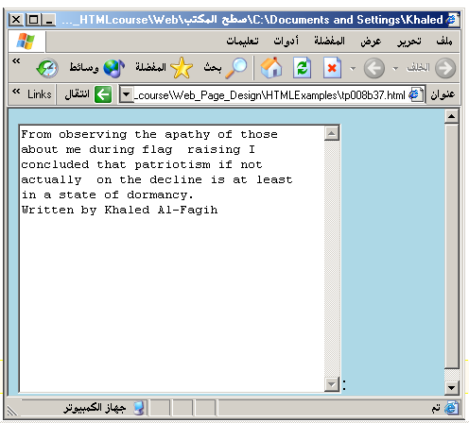
By Akash Kumar Choudhary

Slide 126
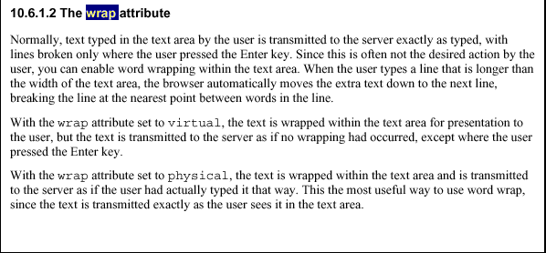
By Akash Kumar Choudhary

Slide 127
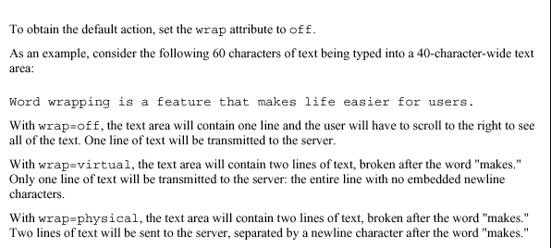




By Akash Kumar Choudhary

Slide 128
Other Elements used in Forms
The two following examples are <SELECT></SELECT> elements, where the attributes are set differently.
The Select elements attributes are:
NAME: is the name of the variable to be sent to the CGI application.
SIZE: this sets the number of visible choices.
MULTIPLE: the presence of this attribute signifies that the user can make multiple selections. By default only one selection is allowed.
By Akash Kumar Choudhary

Slide 129
<BODY bgcolor=lightblue>
<form>
Select the cities you have visited:
<SELECT name=“list” size=5>
<option> London</option>
<option> Tokyo</option>
<option> Paris</option>
<option> New York</option>
<option> LA</option>
<option> KL</option>
</SELECT>
</form>
</BODY>
By Akash Kumar Choudhary

Slide 130
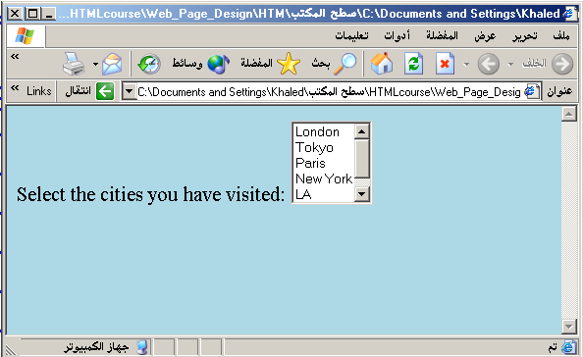
By Akash Kumar Choudhary

Slide 131
Other Elements used in Forms
Drop Down List:
Name: is the name of the variable to be sent to the CGI application.
Size: 1.
By Akash Kumar Choudhary

Slide 132

Other Elements used in Forms
List Box:
Name: is the name of the variable to be sent to the CGI application.
SIZE: is greater than one.
By Akash Kumar Choudhary

Slide 133
Other Elements used in Forms
Option
The list items are added to the <SELECT> element by inserting <OPTION></OPTION> elements.
The Option Element’s attributes are:
SELECTED: When this attribute is present, the option is selected when the document is initially loaded. It is an error for more than one option to be selected.
VALUE: Specifies the value the variable named in the select element.
By Akash Kumar Choudhary

Slide 134
</HEAD>
<BODY>
<h2><font color=blue>What type of Computer do you have?</font><h2>
<FORM>
<SELECT NAME="ComputerType" size=4>
<OPTION value="IBM" SELECTED> IBM</OPTION>
<OPTION value="INTEL"> INTEL</OPTION>
<OPTION value=" Apple"> Apple</OPTION>
<OPTION value="Compaq"> Compaq</OPTION>
</SELECT>
</FORM></BODY></HTML>
By Akash Kumar Choudhary

Slide 135
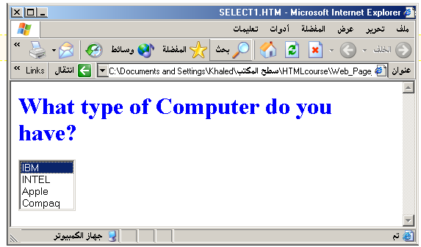
By Akash Kumar Choudhary

Slide 136
<HEAD> <TITLE>SELECT with Mutiple </TITLE> </HEAD>
<BODY>
<h2><font color=blue>What type of Computer do you have?</font><h2>
<FORM>
<SELECT NAME="ComputerType" size=5 multiple>
<OPTION value="IBM" > IBM</OPTION>
<OPTION value="INTEL"> INTEL</OPTION>
<OPTION value=" Apple"> Apple</OPTION>
<OPTION value="Compaq" SELECTED> Compaq</OPTION>
<OPTION value=" other"> Other</OPTION>
</SELECT>
</FORM></BODY></HTML>
By Akash Kumar Choudhary

Slide 137
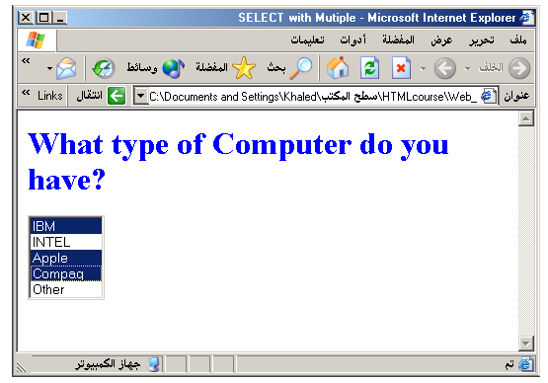
By Akash Kumar Choudhary

Slide 138
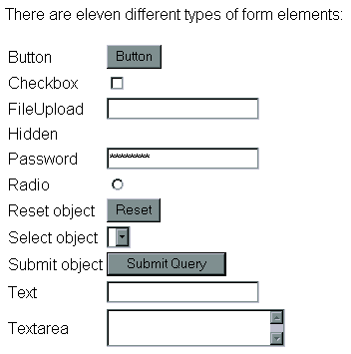
By Akash Kumar Choudhary

